Slide 1
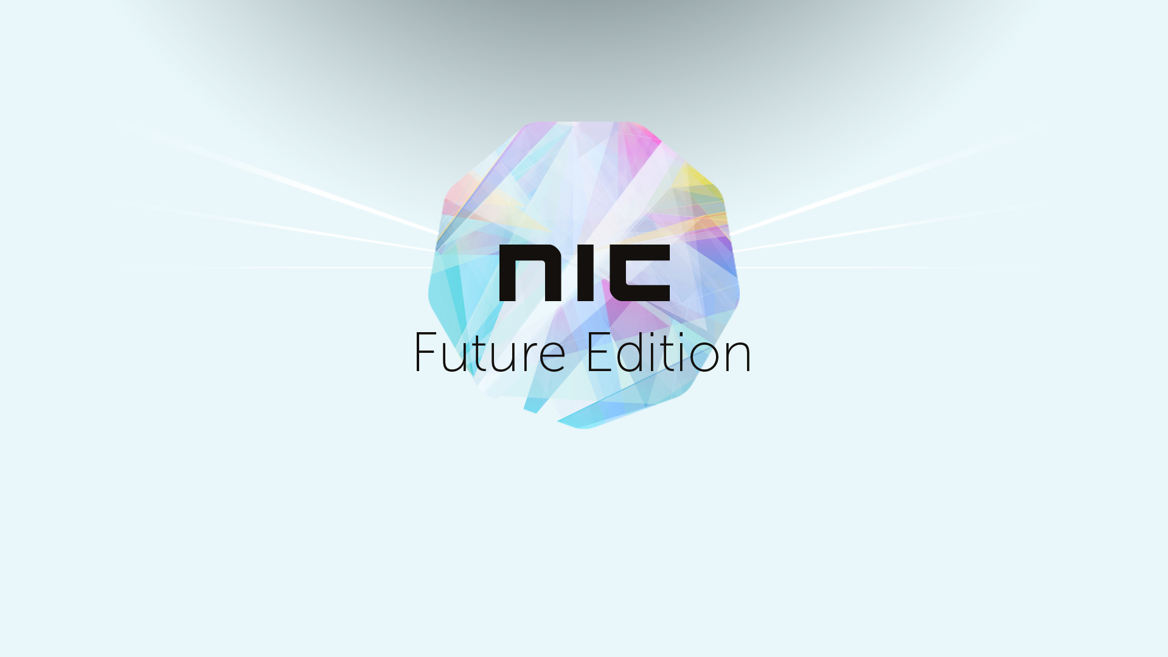

Slide 2

Is fighting Ransomware impossible? Yes, but...

Slide 3

About me
Mike Resseler
Director, Product Management @ Veeam Software
@MikeResseler

Slide 4
What is Ransomware?
A type of malicious software (malware) which restricts access to a computer and/or the files on a computer until a ransom amount is paid.
Spreads via cryptovirology
Encrypts and holds ransom sensitive data
Sometimes threatens to leak sensitive information
Combines asymmetric and symmetric encryption to lock out user from managed file transfer (MFT) or specific directories or files
Operates under the assumption that the encrypted data is important enough to users that they are willing to pay a ransom

Slide 5
Techniques
Lockscreen Ransomware
Encryption Ransomware
Master Boot Record Ransomware
Mobile Device Ransomware
Fakeware
Stopping certain applications

Slide 6
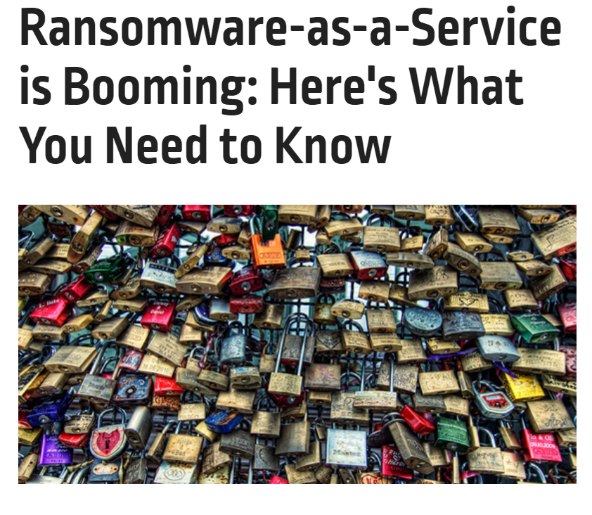
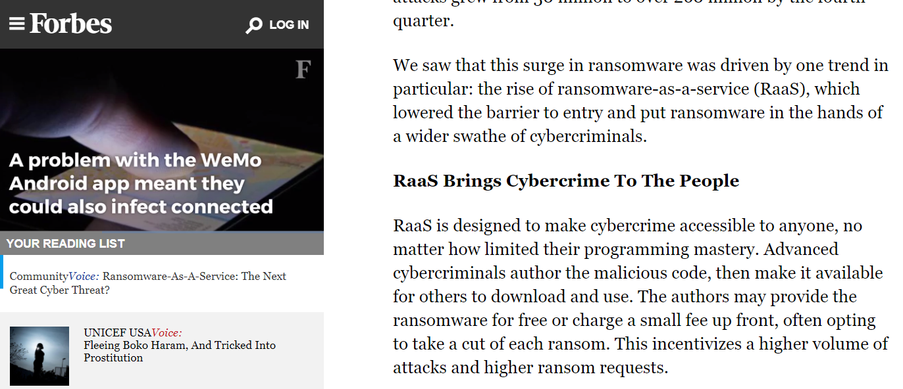
Ransomware General Information
Ransomware as a service (RaaS)

Slide 7
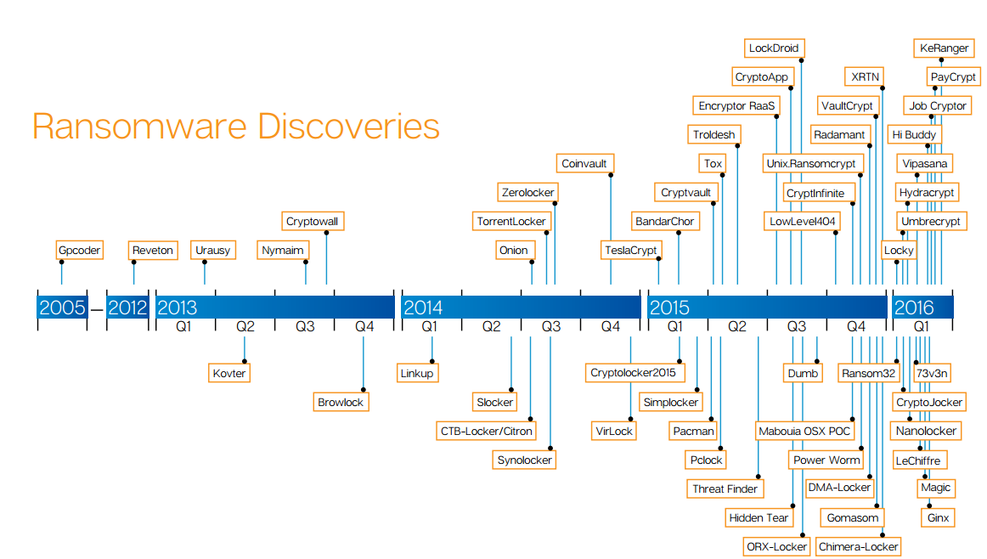
This stuff is real….

Slide 8
Recent Veeam poll
We polled Veeam customers and prospects on ransomware and found some interesting data (nearly 1,000 responses):
Nearly 46% of the respondents have had some form of ransomware incident in the last two years.
Of those who had a ransomware incident, 91% had data encrypted.

Slide 9
Recent Veeam poll (continued)
Only 2% of the respondents admitted to paying the ransom for recovering their data.
Of that small sample who paid the ransom, all but one of them paid less than USD $10,000.
84% of the respondents were able to recover their data without paying the ransom.

Slide 10
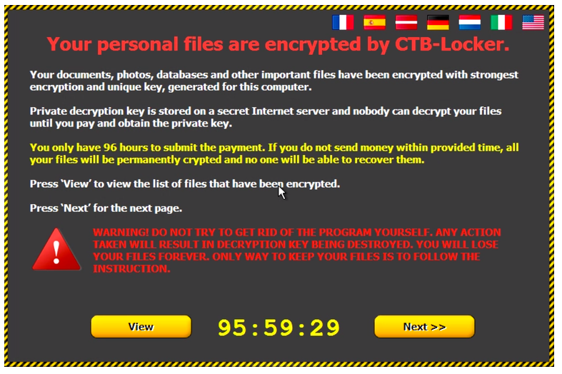
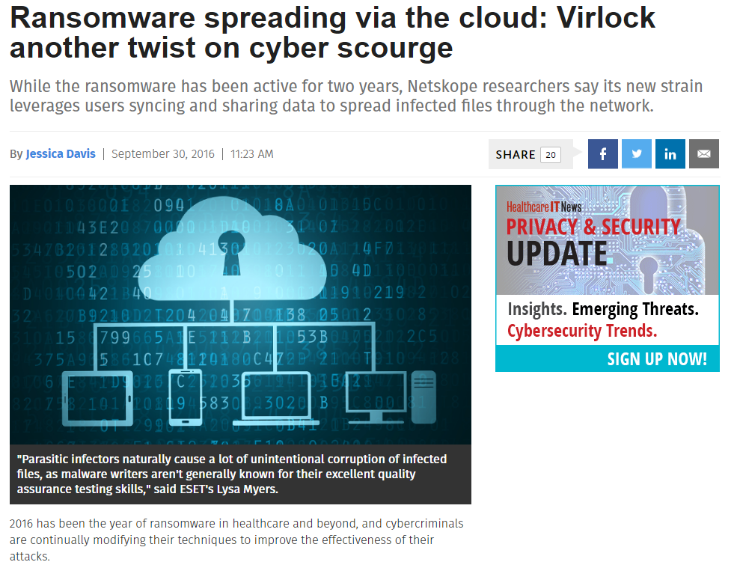
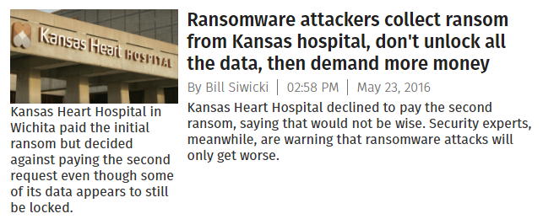
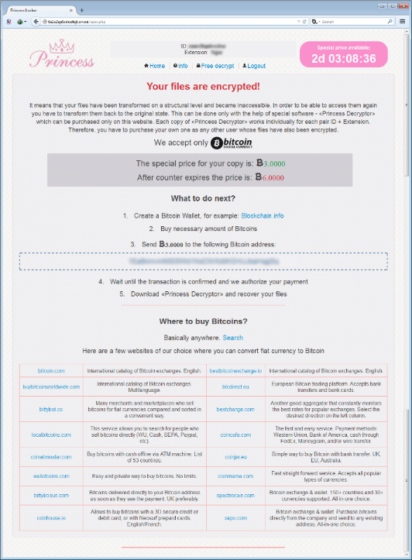
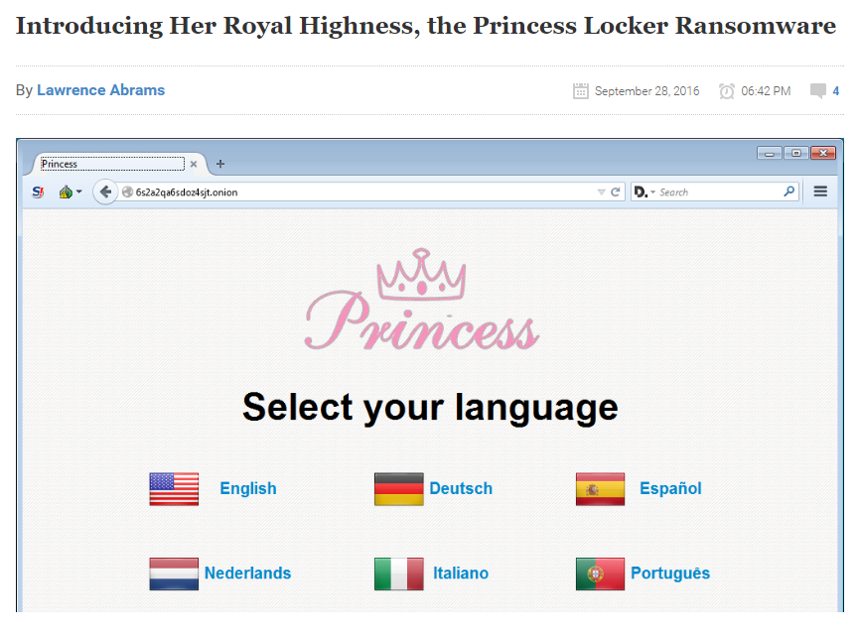
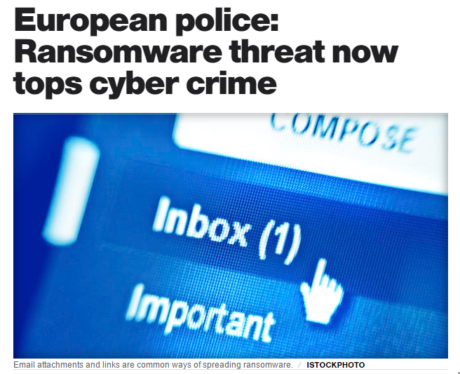
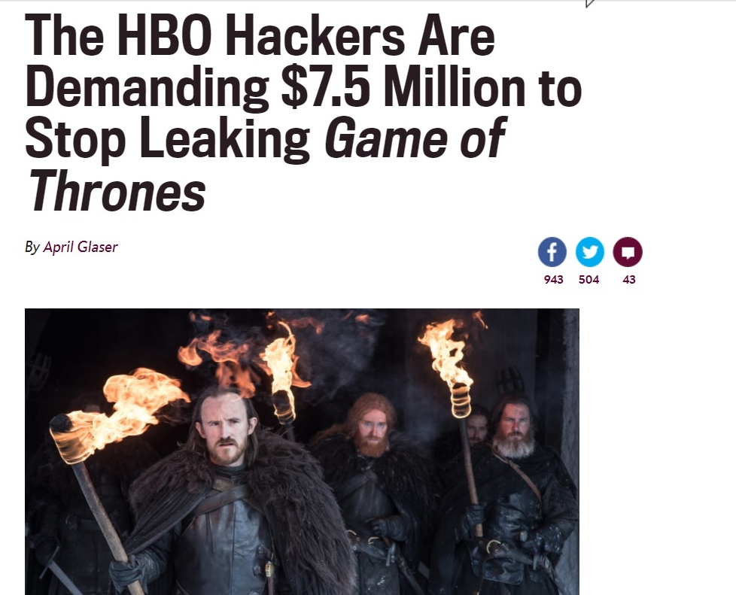
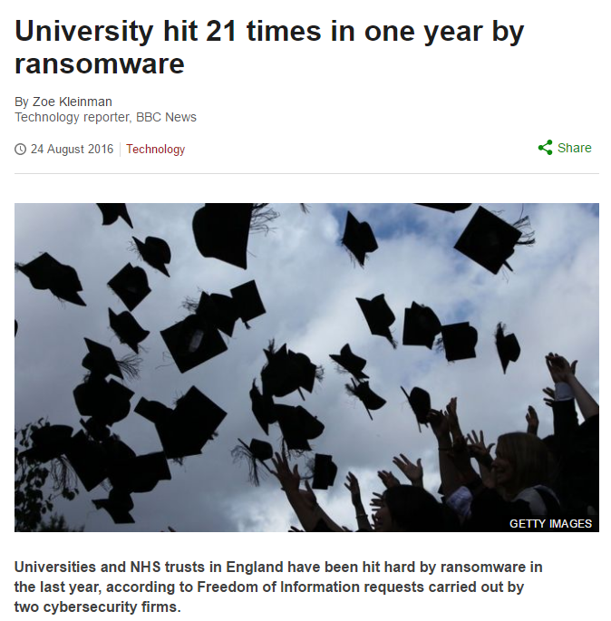
Ransomware in the news
Affects all industries worldwide

Slide 11
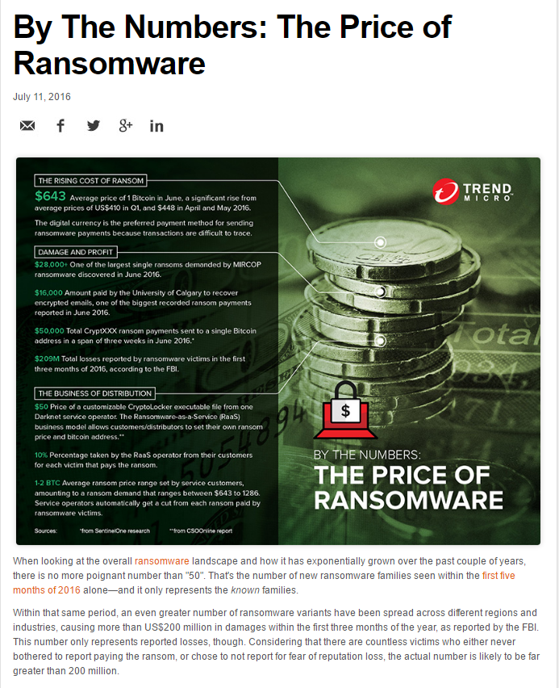
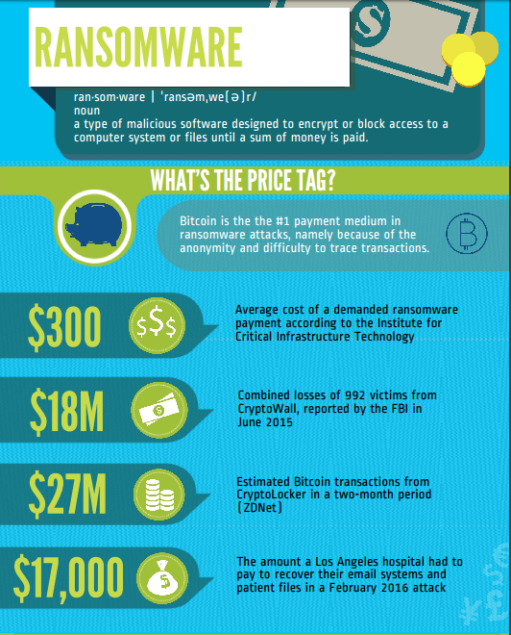
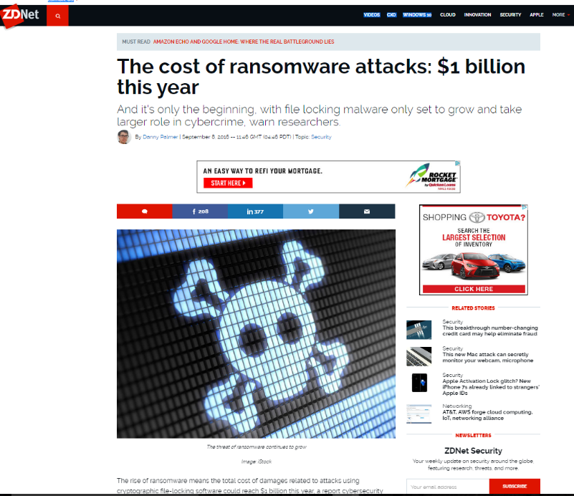
The cost of ransomware — depends who you ask

Slide 12


Slide 13
Payments
What is the right price?
US $189 (AIDS)
Now between 21$ and 700$ (inflation based 368$ in 2015) so remains the same
Dynamic pricing (often geo-located)
Low-price (massive volume) versus high-price (low volume)
Business specifically targeted (sweet spot around 10.000 $)

Slide 14
Common infection approaches
Trojans: the most common attack vector; email attachments that contain malicious macro attachments are the chosen method here
Removable media: very simple way to infect a PC as users generally trust those devices
Ex. A study by Google and two US universities: dropping an USB stick in public places was a simple and effective way to trigger human curiosity, with a full 49% of the ‘bait USBs’ being plugged into a computer by people who found them.
Malvertising: attackers compromise the weak infrastructure of an online ad network that serves adverts to legitimate websites. Users are tricked to download malware through display ads
Social media and SMS: ransomware is delivered through shortened links; it is often JavaScript based, so it requires little action on the users part, other than to click the link
Ransomware-as-a-Service: has given rise to vast affiliate networks, where ransomware is easy to deploy and manage for almost anyone, and where the earning potential is significant

Slide 15
Common infection approaches (continued)
Email with links and/or attachments (invoices)
Attackers may use vulnerabilities of your browser, OS or installed software
Skype or any other messengers may distribute infecting links (compromised trusted contacts)
Visiting untrusted sites (torrents, cracked software)
Downloading/running untrusted software
Methods are always changing to adapt to new and old vulnerabilities

Slide 16
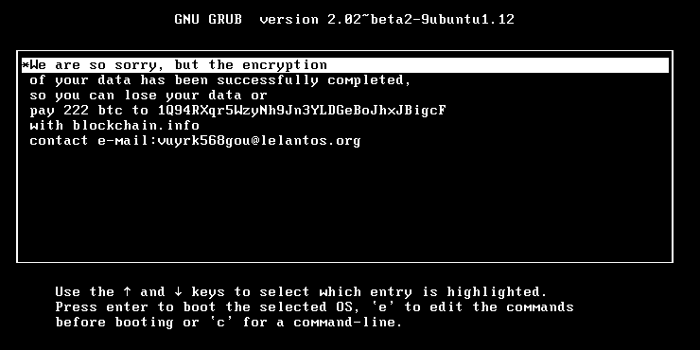
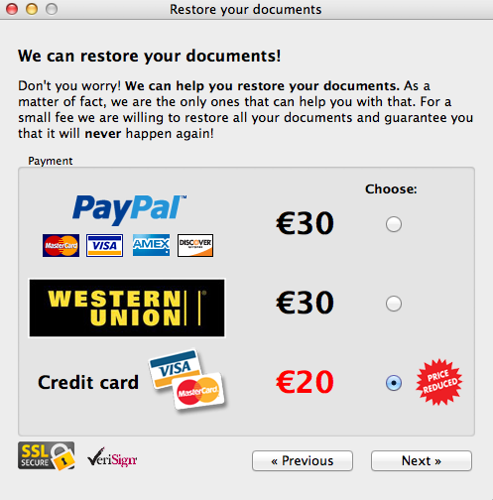
All systems go
While most ransomware targets the Windows desktop, there is also Linux or macOS ransomware
Linux KillDisk ransom message
FileCoder ransom message

Slide 17

Be prepared
Better safe than sorry

Slide 18
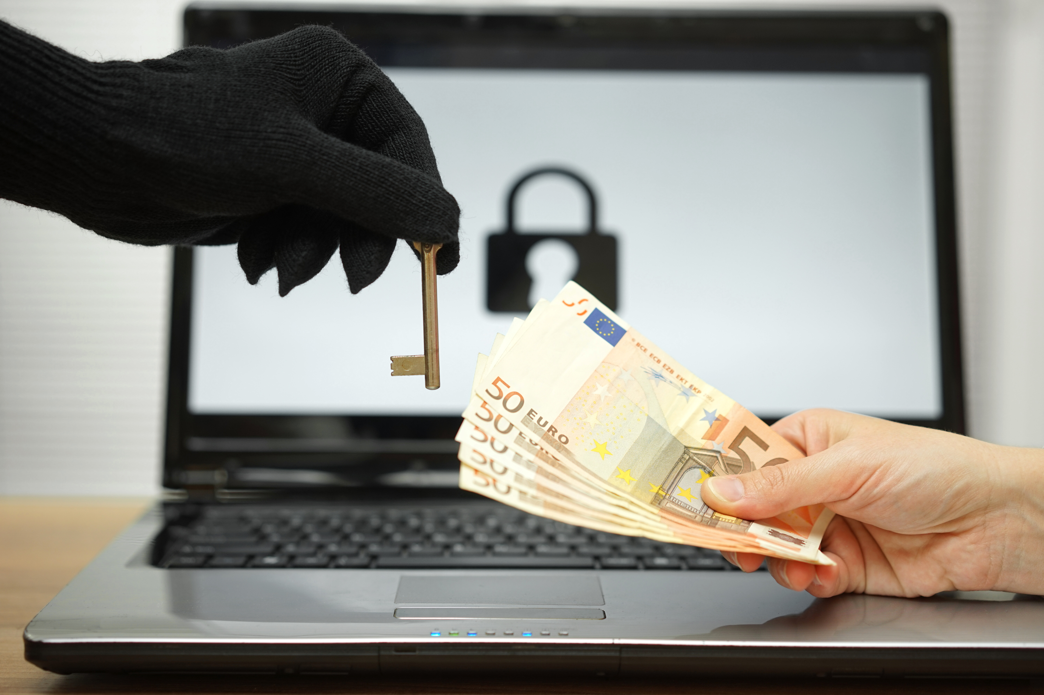
You can pay… (NO!)

Slide 19

You can restore… (YES!)

Slide 20

Contact authorities: www.ic3.gov

Slide 21

Have you seen my defense?

Slide 22

#0
So now what?
Cross my fingers?

Slide 23
#1
It is not a project!
It is a process

Slide 24

It is not about IT alone!

Slide 25
#2
I have AntiVirus
Good for you!

Slide 26
Antivirus effectiveness
While antivirus does update their libraries to protect from certain variants, there is no single tool that will protect you 100% from a ransomware attack
A false sense of security can occur when using antivirus solutions
It is still important to ensure that your antivirus and anti-malware solutions are modern and auto-updated
Ransomware can adapt and overcome traditional security solutions like AV and gateways; get these basics rights and you are only half way to being protected

Slide 27
#3
Threat Analysis
Not just once!

Slide 28

Routine Audit & Security
Checking on a routine basis that permissions within the environment are up to scratch and that people do not have access to files and shares they shouldn’t.

Slide 29
#4
Show file extensions
And educate

Slide 30
#5
Javascript files?
Open them in notepad

Slide 31
#6
Do not enable macro’s
Nope! Just don’t

Slide 32
#7
Attachments
Scanner & Education

Slide 33
#8
User rights
No you do not need…

Slide 34
#9
Microsoft office viewers for the win…

Slide 35
#10
Patch! Patch! Patch!
Please

Slide 36

Updates
There are releases all the time around preventive patches that will keep vulnerabilities at bay just by adhering to an update schedule.

Slide 37
#11
Passwords!
Education… Again!

Slide 38

Tqbfj0Tld!
NicConferenceReallyRocks!

Slide 39
#12
Network
segmentation

Slide 40
#13
Online Cloud Storage
Use versions…

Slide 41
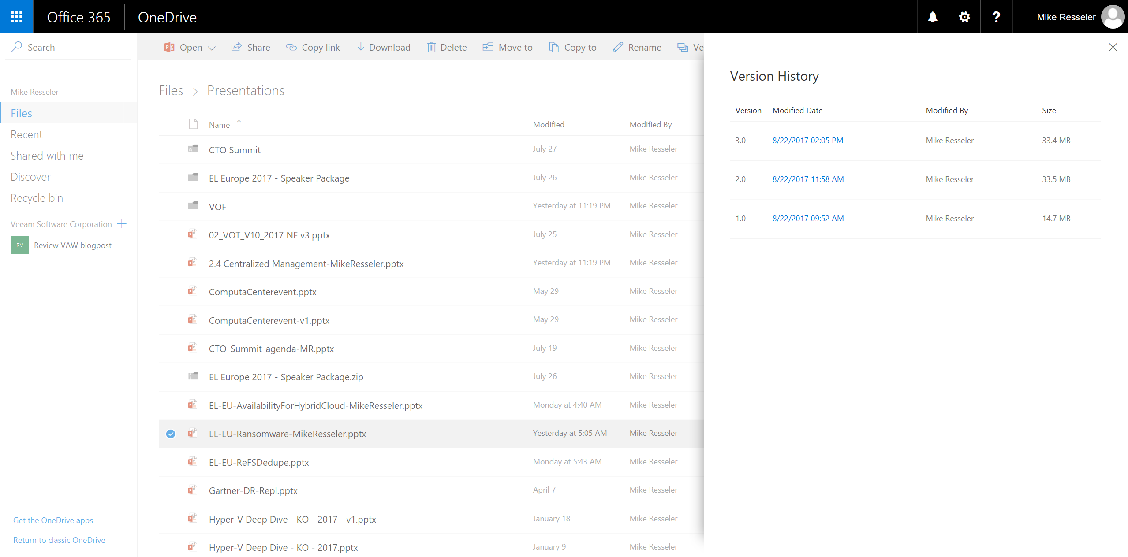

Slide 42
#14
USB Disks
Unattached…

Slide 43
#15
3 year roadmap?
Is dead

Slide 44
#16
Backups!
Not even saying please…

Slide 45

Backup, Backup, Backup
Make sure pertinent data is backed up and preferably NOT accessible to the standard user!

Slide 46

Tip
Master 3-2-1 Rule

Slide 47

Air gap
Offline storage is the single most effective ransomware resiliency technique

Slide 48
Resources
Slides and demos from the conference will be available at github.com/nordicinfrastructureconference/2018 (bit.ly/2y7JhA3)

Slide 49

Thank You

